Slide 1
An Introduction to Deep Reinforcement Learning
Vishal A. Bhalla
Technical University of Munich (TUM), Germany
Talk @ Big Data & Data Science Meetup | Bogotá, Colombia, 4th Sep ‘17.
Notes:
Good Evening everyone! Hope you have settled down.
Firstly, it is good to see almost a full house Or close to 180 people turn up for today’s event. Thank you for coming over.
A big thank you to the Alejandro, all other co-organizers and the Big Data & Data Science Meetup group for organizing this event and giving me the chance to present this topic.
I am Vishal Bhalla and today I would like to welcome you all in this talk on “An Introduction to Deep Reinforcement Learning”. Hope you enjoy it.

Slide 2




About Me
Masters Student in Informatics (CS) at Technical University of Munich (TUM)
Major focus in Artificial Intelligence (AI) & Natural Language Understanding (NLU)
Applied wide range of Machine Learning (ML) algorithms in Automotive, Robotics, Medical Imaging & Security domains
Interested in exploring Deep Reinforcement Learning (RL) methods for NLU & Dialogue Systems
Happy to connect for collaborations on novel and challenging projects
An Introduction to Deep Reinforcement Learning “Big Data & Data Science Meetup” 4th Sep 2017 @ Bogotá, Colombia Vishal Bhalla, Student M Sc. Informatics @ TUM
Notes:
Before I begin my presentation, a short introduction about myself:
I am a Masters Student in Informatics at the Technical University of Munich (TUM).
My major focus is in Artificial Intelligence & NLU i.e. Natural Language Understanding
I have applied a wide range of Machine Learning algorithms across the Automotive, Robotics, Medical Imaging & Security domains
And currently, I am interested in exploring the use of Deep Reinforcement Learning for NLU & Dialogue Systems.
I am always on the lookout for collaborating on novel and challenging projects and would be more than happy to connect through any of the 4 mediums listed here: Action: Highlighted the contact details

Slide 3
Agenda
Introduction
Theory & Concepts
Use cases
Key Players & Toolkits
Research Frontiers
Envoi
An Introduction to Deep Reinforcement Learning “Big Data & Data Science Meetup” 4th Sep 2017 @ Bogotá, Colombia Vishal Bhalla, Student M Sc. Informatics @ TUM
Notes:
The Agenda for the talk is as follows:
I start off by Introducing this topic with the motivation behind using such systems and their multifarious applications
Then I cover all the Theory & background, describing the concepts
Next up, I touch base upon all different Approaches and examples using Deep RL
I will also briefly go over some Toolkits offered by key players and the active research in this community
And then in particular I will also talk about the challenges, research frontiers and limitations.
Lastly, I conclude the talk with some final remarks, References & Additional Reading
Moreover, I would like to make it a bit more interactive, rather than you just listening and asking questions at the end. So feel free to interrupt if anything is unclear or if you have questions.

Slide 4
Introduction
Notes:
Let’s begin …

Slide 5
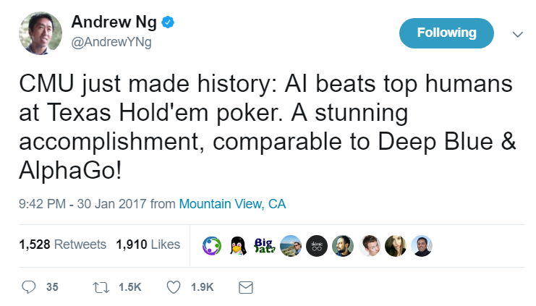
Motivation
Goes beyond input-output pattern recognition
Synergy of Deep Neural Networks + Reinforcement Learning
‘Mapping’ sensors to actions
Build new applications
An Introduction to Deep Reinforcement Learning “Big Data & Data Science Meetup” 4th Sep 2017 @ Bogotá, Colombia Vishal Bhalla, Student M Sc. Informatics @ TUM
Notes:
What is the motivation behind using Deep Reinforcement Learning (DeepRL) and what are its multifarious applications?
The next generation AI systems will need to go beyond input-output pattern recognition (like in the case for speech, vision, machine translation) to generate intelligent behavior.
These successes have relied on the synergy between deep neural nets and reinforcement learning, i.e. deep reinforcement learning (Deep RL).
Deep RL gives us the ability to build new fascinating applications using these techniques as research pushes the algorithmic frontier even further.
Interpret rich sensory inputs → Deep learning is really good at this
Choose complex actions → Reinforcement learning is really good at this
Use deep networks to represent mapping from sensors to actions
Subsumes estimation, control, etc.
Requires scaling to huge functions

Slide 6
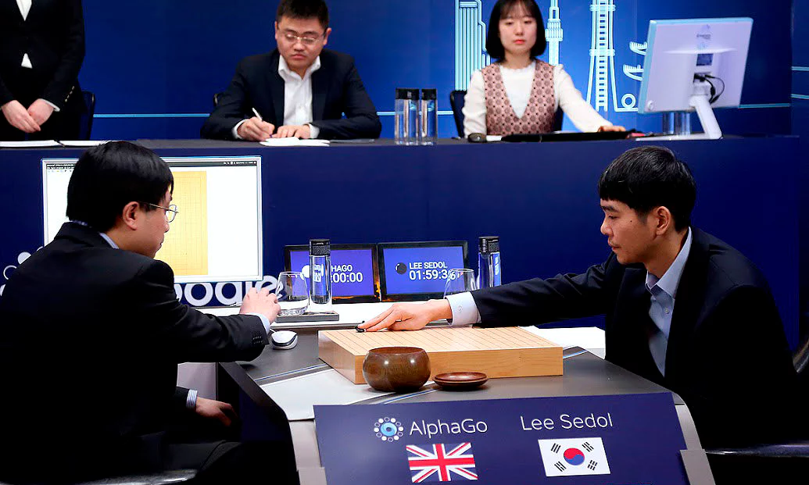
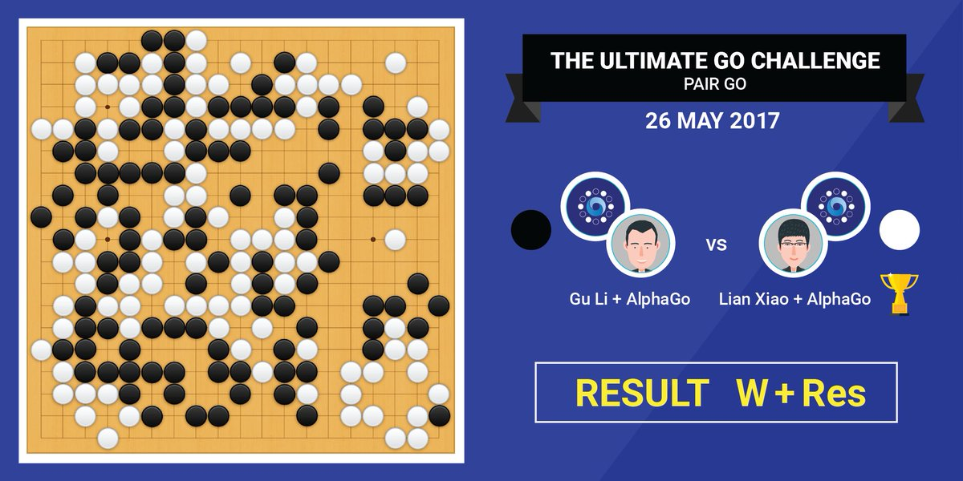
Major breakthrough!
AlphaGo defeating the Go World Champion
Image courtesy: The Guardian
Image courtesy: Twitter - Deep Mind AI
An Introduction to Deep Reinforcement Learning “Big Data & Data Science Meetup” 4th Sep 2017 @ Bogotá, Colombia Vishal Bhalla, Student M Sc. Informatics @ TUM
Notes:
The 1st major breakthrough was when DeepMind’s artificial intelligence (primarily using Deep RL algorithms underneath) first defeated a human opponent in 2016 and yet again in May 2017!
This offers evidence of mastering a major challenge in a game where the number of moves is more than the number of atoms in the known universe!
What was interesting is that it could pair up with a human for a 2-player games as well!

Slide 7
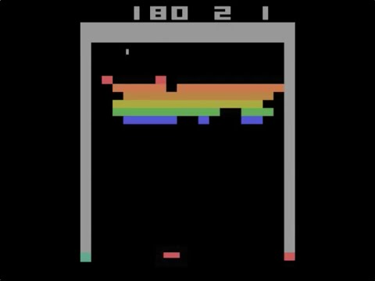
Applications
Learning to play Atari games from raw pixels
Video courtesy: YouTube @DeepMind - DQN Breakout
An Introduction to Deep Reinforcement Learning “Big Data & Data Science Meetup” 4th Sep 2017 @ Bogotá, Colombia Vishal Bhalla, Student M Sc. Informatics @ TUM
Notes:
Another gaming application when it mastered playing Atari
After 600 episodes, the underlying algorithm DQN finds and exploits the optimal strategy in this game, which is to make a tunnel around the side, and then allow the ball to hit blocks by bouncing behind the wall. Note: the score is displayed at the top left of the screen

Slide 8

Applications (2)
Games
Robotics
Autonomous Driving
Energy Conservation
Healthcare
Dialogue Systems
Marketing
Video courtesy: Bipedal Walker - Evolution Strategy Variant + OpenAI Gym
An Introduction to Deep Reinforcement Learning “Big Data & Data Science Meetup” 4th Sep 2017 @ Bogotá, Colombia Vishal Bhalla, Student M Sc. Informatics @ TUM
Notes:
The applications of using Deep RL are not just limited to Games.
It has also found use in Robotics, Self- Driving Vehicles, Healthcare, Dialogue Systems, Energy & Marketing sectors!
Here you can see how a Bipedal Walker learns. It is an Evolution Strategy Variant using OpenAI Gym, both which will be covered later in the talk.

Slide 9
Applications (3)
Producing flexible behaviours in simulated environments
GIF courtesy: Deep Mind Blog
An Introduction to Deep Reinforcement Learning “Big Data & Data Science Meetup” 4th Sep 2017 @ Bogotá, Colombia Vishal Bhalla, Student M Sc. Informatics @ TUM
Notes:
Another use case is of Producing flexible behaviours in simulated environments

Slide 10
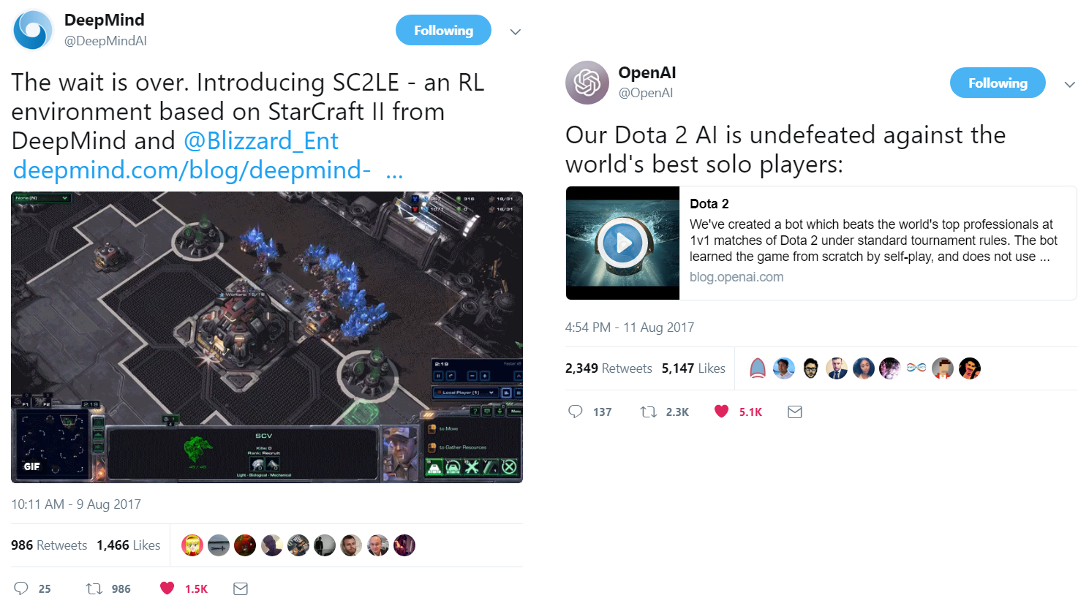
Applications (4)
AI research in the real-time strategy game StarCraft II & DOTA 2
Image courtesy: (L) SC2LE - an RL environment based on StarCraft II from DeepMind & Blizzard and (R) A bot which beats the world’s top professionals at 1v1 matches of Dota 2 under standard tournament rules
An Introduction to Deep Reinforcement Learning “Big Data & Data Science Meetup” 4th Sep 2017 @ Bogotá, Colombia Vishal Bhalla, Student M Sc. Informatics @ TUM
Notes:
The competition is heating up!
After Go, this is believed to be the next frontier for AI; to master more complex games of Starcraft and DOTA 2!

Slide 11
RL Theory & Concepts
Notes:
That’s it with the introduction and applications
Next up let’s look at some basic building blocks and concepts that constitute Reinforcement Learning as it relates to Deep RL!

Slide 12
Reinforcement Learning (RL)
Inspired by research into animal learning
Correct input/label pairs are never presented
On-line performance focus
Used in environments where,
No analytic solution
Simulation Model
Interaction only
An Introduction to Deep Reinforcement Learning “Big Data & Data Science Meetup” 4th Sep 2017 @ Bogotá, Colombia Vishal Bhalla, Student M Sc. Informatics @ TUM
Notes:
RL methods were originally inspired by research into animal learning, stimulating the emergence of the field of reinforcement learning (RL).
In RL, the correct input/output pairs are never presented, nor sub-optimal actions explicitly corrected. This makes RL different from standard supervised learning
Moreover, there is a focus on online performance that involves finding a balance between exploration (of uncharted territory) and exploitation (of current knowledge).
Reinforcement learning can be used in large environments in any of the following situations:
A model of the environment is known, but an analytic solution is not available;
Only a simulation model of the environment is given (the subject of simulation-based optimization)
The only way to collect information about the environment is by interacting with it.

Slide 13
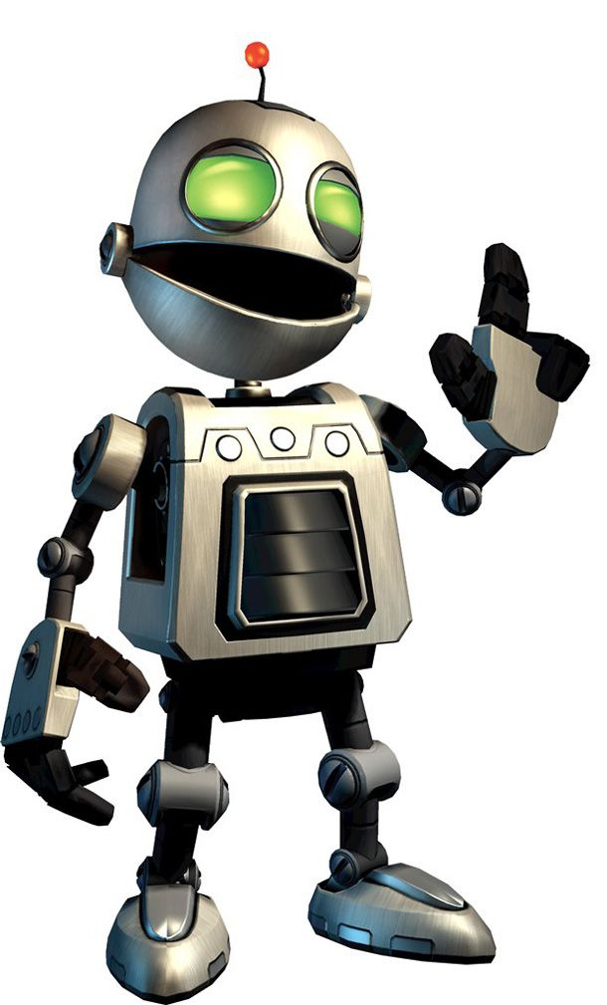
Typical RL scenario
Environment
State
Action
Reward
Agent
An Introduction to Deep Reinforcement Learning “Big Data & Data Science Meetup” 4th Sep 2017 @ Bogotá, Colombia Vishal Bhalla, Student M Sc. Informatics @ TUM
Notes:
So how does a typical RL scenario look like?
At each time t, the agent receives an observation o_{t}, which typically includes the reward r_{t}. It then chooses an action a_{t} from the set of actions available, which is subsequently sent to the environment.
An agent takes actions in an environment which is interpreted into a reward and a representation of the state which is fed back into the agent.
RL methods address the problem of how to maximize future reward by mapping states in the environment to actions.
The environment moves to a new state s_{t+1} and the reward r_{t+1} associated with the transition (s_{t}, a_{t}, s_{t+1}) is determined.

Slide 14
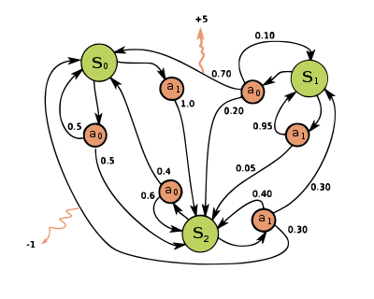
Markov Decision Processes (MDPs)
Tuple <S, A, P, R, 𝛾, H >
State transition model p(s_{t+1} | s_{t}, a_{t}) where, s - state & a - action
Reward p(r_{t+1} | s_{t}, a_{t})
Depends on the current state and the action performed
Discount factor 𝛾 ∈ [0,1]
Controls the importance of future rewards
Deterministic vs Stochastic environment
A simple MDP Image courtesy: Wikipedia
An Introduction to Deep Reinforcement Learning “Big Data & Data Science Meetup” 4th Sep 2017 @ Bogotá, Colombia Vishal Bhalla, Student M Sc. Informatics @ TUM
Notes:
As you have seen the state-action transition is a Markov Decision Process (MDP) that is derived from a Markov Chain.
It is a 5 tuple sometimes 6 if you include the Horizon ‘H’.
At each time step the state of the environment is an element s ∈ S and the agent chooses an action a ∈ A to perform.
State transition model that describes how the environment state changes when the user performs an action a_{t} in the current state s_{t} i.e. the Markov property
Model describes the real-valued reward value that the agent receives from the environment after performing an action.
In MDP the the reward value depends on the current state and the action performed.
Discount Factor: It controls the importance of future rewards and is always within the range of 0 to 1.
Deterministic vs Stochastic environment
Deterministic environment means that both state transition model and reward model are deterministic functions.
If the agent while in a given state repeats a given action, it will always go the same next state and receive the same reward value.
In a stochastic environment there is uncertainty about the actions effect.
When the agent repeats doing the same action in a given state, the new state and received reward may not be the same each time.
Deterministic environments are easier to solve, because the agent knows how to plan its actions with no-uncertainty given the environment MDP.

Slide 15
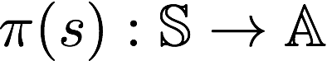
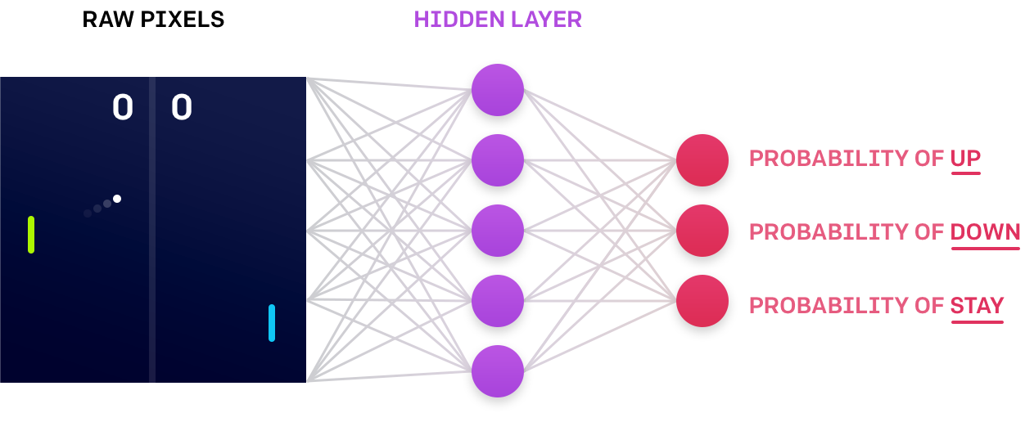
Policy
Agent - Choice of which action to perform
Policy - Function of current environment state
Action - Returns the best one
Image courtesy: OpenAI Blog on Evolution Strategies
An Introduction to Deep Reinforcement Learning “Big Data & Data Science Meetup” 4th Sep 2017 @ Bogotá, Colombia Vishal Bhalla, Student M Sc. Informatics @ TUM
Notes:
In reinforcement learning world, the function that maps observations to actions is known as the policy function.
As you can see in the formulation, the Policy is a function of the current environment state and basically it gives the agent the choice of which action to perform from a set of actions and returns the best or optimal one!
Types -
Value Function
Value Iteration
Policy Iteration
In practice, the policy is usually a neural network that takes the current state of the game as an input and calculates the probability of taking any of the allowed actions as seen in the figure for a game of ping-pong!

Slide 16
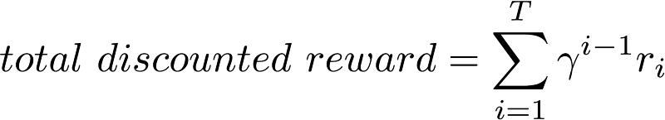
Rewards
Agent’s goal: Pick best policy that maximises total reward
Naive approach - Sum up rewards at each time step
where, T is the horizon (episode length) which can be infinity
Discount factor (𝛾) importance
Reward doesn’t go to infinity as 0 ≤ 𝛾 ≤ 1
Preference for immediate rewards
Eg: Robots learning to walk
Reward: Head position
An Introduction to Deep Reinforcement Learning “Big Data & Data Science Meetup” 4th Sep 2017 @ Bogotá, Colombia Vishal Bhalla, Student M Sc. Informatics @ TUM
Notes:
Goal of the agent is to pick the optimal policy which produces the maximum possible total reward.
Discount factor gives higher weight to rewards received near than rewards received further in the future.
Discount factor is to prevent the total reward from going to infinity
Robot in a maze with two paths leading to the goal state,
A longer path that gives higher reward
A shorter path with smaller reward.
The 𝛾 value decides which one to choose!
For example, think about a robot or a stick figure trying to learn how to walk. One possible reward could be if it could put its head at the highest level from ground and that to for most of the time. If we could maximise this reward we could make it to walk.

Slide 17
Policy Decision
Brute force
Sample returns after following each policy
Chose one with largest expected return
Issues
Large or infinite policies
Large no. of samples required to handle variance of returns
Solutions
Give some structure
Allow samples of one policy to influence estimates of other
An Introduction to Deep Reinforcement Learning “Big Data & Data Science Meetup” 4th Sep 2017 @ Bogotá, Colombia Vishal Bhalla, Student M Sc. Informatics @ TUM
Notes:
Now coming to deciding the policy,
The brute force approach entails the following two steps:
For each possible policy, sample returns while following it
Choose the policy with the largest expected return
However this comes with its own set of problems
One problem with this is that the number of policies can be extremely large, or even infinite.
Another is that variance of the returns might be large, in which case a large number of samples will be required to accurately estimate the return of each policy.
These problems can be ameliorated
If we assume some structure and
Perhaps allow samples generated from one policy to influence the estimates made for another.
The two main approaches for achieving this are value function estimation and direct policy search which will be covered in the next few slides.

Slide 18
Types
Model based
Agent knows the MDP model
Agent uses it to (offline) plan actions before any interactions with environment
Eg: Value-iteration & policy-iteration
Model Free
Initial knowledge about possible state-actions but not MDP model
Improves (online) through learning from the interactions with the environment
Eg: Q-Learning
An Introduction to Deep Reinforcement Learning “Big Data & Data Science Meetup” 4th Sep 2017 @ Bogotá, Colombia Vishal Bhalla, Student M Sc. Informatics @ TUM
Notes:
But before going into value functions and policy search, let’s look at the 2 main types of RL approaches
Model based
Model based approaches are based on the assumption that the agent knows the MDP model of the world (i.e. the agent knows the state-transition and reward probability functions).
Therefore, they can be used by the agent to plan its actions given knowledge about the environment before interacting with it. And this is done (offline) most of the times!
Good examples would be Value-iteration & policy-iteration.
Model free
In contrast, in Model free approaches the agent initially knows only the possible states and actions but not the state-transition and reward probability functions.
For example, in Q-learning the agent improves its behavior (online) through learning from the history of interactions with the environment.

Slide 19
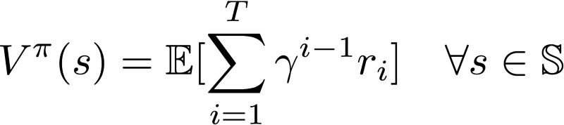
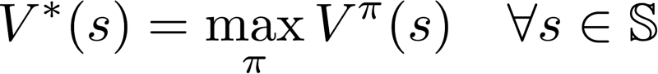
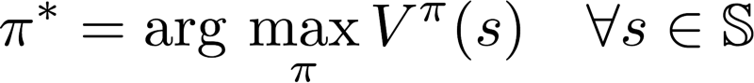
Value Function
Goodness of a state
Expected total reward from start state s
Depends on the policy
There exists an optimal value function with the highest value
Optimal policy 𝛑*
An Introduction to Deep Reinforcement Learning “Big Data & Data Science Meetup” 4th Sep 2017 @ Bogotá, Colombia Vishal Bhalla, Student M Sc. Informatics @ TUM
Notes:
The value function represent how good is a state for an agent to be in.
It is equal to expected total reward for an agent starting from state s.
The value function depends on the policy by which the agent picks actions to perform.
So, if the agent uses a given policy 𝛑 to select actions, the corresponding value function is given by:
Among all possible value-functions, there exist an optimal value function that has higher value than other functions for all states.
The optimal policy 𝛑* is the policy that corresponds to optimal value function.

Slide 20
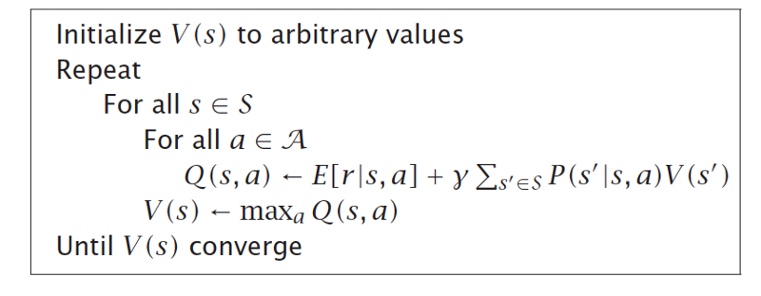
Value Iteration
Iteratively compute optimal state value function V(s)
Guaranteed to converge to optimal values
An Introduction to Deep Reinforcement Learning “Big Data & Data Science Meetup” 4th Sep 2017 @ Bogotá, Colombia Vishal Bhalla, Student M Sc. Informatics @ TUM
Notes:
Value iteration computes the optimal state value function by iteratively improving the estimate of V(s).
The algorithm initialize V(s) to arbitrary random values. It repeatedly updates the Q(s, a) and V(s) values until they converge.
Value iteration is guaranteed to converge to the optimal values.
The algorithm for Value Iteration is as below.

Slide 21
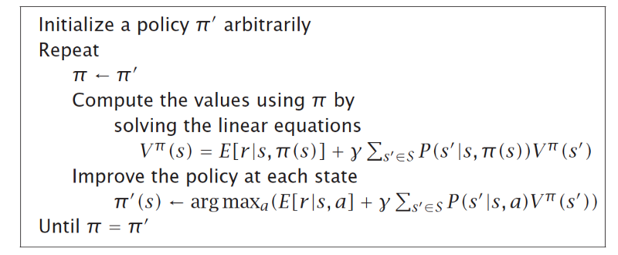
Policy Iteration
Re-define the policy at each step
Compute value function for this new policy until the policy converges
Guaranteed to converge
An Introduction to Deep Reinforcement Learning “Big Data & Data Science Meetup” 4th Sep 2017 @ Bogotá, Colombia Vishal Bhalla, Student M Sc. Informatics @ TUM
Notes:
While value-iteration algorithm keeps improving the value function at each iteration until the value-function converges.
As you might have noticed (flip 2 slides back), the agent only cares about the finding the optimal policy, and at times the optimal policy will converge before the value function.
Therefore, another algorithm called policy-iteration instead of repeatedly improving the value-function estimate, it will re-define the policy at each step and compute the value according to this new policy until the policy converges.
Policy iteration is also guaranteed to converge to the optimal policy.
The pseudo code for Policy Iteration is shown below.

Slide 22
Value vs Policy Iteration
Used for Offline planning
Prior knowledge about MDP
Policy Iteration is computationally efficient compared to Value Iteration
Takes fewer iterations to converge
However, each iteration is computationally expensive
An Introduction to Deep Reinforcement Learning “Big Data & Data Science Meetup” 4th Sep 2017 @ Bogotá, Colombia Vishal Bhalla, Student M Sc. Informatics @ TUM
Notes:
Now, what is the similarity and difference between Value and Policy difference then?
Both value-iteration and policy-iteration algorithms can be used for offline planning where the agent is assumed to have prior knowledge about the effects of its actions on the environment
As they assume the MDP model is known.
Comparing to each other,
Policy-iteration is computationally efficient as it often takes considerably lesser iterations to converge
However, although each iteration is more computationally expensive.

Slide 23
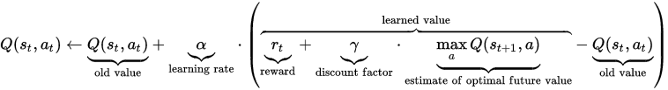
Q Learning
Model free
Quality of certain action in given state
Q(s_{t},a_{t}) = max_{π}R_{t+1} such that π(s) = argmax_{a}Q(s,a)
Bellman equation → Q(s,a) = r + γ.max_{a’}Q(s′,a′)
Iterative Algorithm
Q-function will converge and represent the true Q-value
An Introduction to Deep Reinforcement Learning “Big Data & Data Science Meetup” 4th Sep 2017 @ Bogotá, Colombia Vishal Bhalla, Student M Sc. Informatics @ TUM
Notes:
One of the strengths of Q-learning is that it is able to compare the expected utility of the available actions without requiring a model of the environment. Additionally, Q-learning can handle problems with stochastic transitions and rewards, without requiring any adaptations.
It is called Q-function, because it represents the “quality” of certain action in given state.
The way to think about Q(s,a) is that
It is “the best possible score at the end of game after performing action a in state s”.
Q-learning as saying "here's policy iteration, let's try to take samples, oh no it's hard to take samples when you have a max over actions, so lets have a new kind of value that takes both states *and* actions, let's call it a Q-value, now it works let's call it Q-learning".
Once you have the magical Q-function, the answer becomes really simple – pick the action with the highest Q-value!
Bellman Equation
It is quite logical – maximum future reward for this state and action is the immediate reward plus maximum future reward for the next state.
The main idea in Q-learning is that we can iteratively approximate the Q-function using the Bellman equation
α in the algorithm is a learning rate that controls how much of the difference between previous Q-value and newly proposed Q-value is taken into account. In particular, when α=1, then two Q[s,a]-s cancel and the update is exactly the same as Bellman equation.
The learning rate or step size determines to what extent the newly acquired information will override the old information. A factor of 0 will make the agent not learn anything, while a factor of 1 would make the agent consider only the most recent information. In fully deterministic environments, a learning rate of of 1is optimal. When the problem is stochastic, the algorithm still converges under some technical conditions on the learning rate that require it to decrease to zero. In practice, often a constant learning rate is used, such as 0.1 for all t.

Slide 24
Going Deep (RL)!
Notes:
That’s all with the basic building blocks and concepts that constitute Reinforcement Learning. Now this should help us take a deeper dive that to Deep RL!

Slide 25
Deep Q-Learning
Q-Learning uses tables to store data
Combine function approximation with Neural Networks
Eg: Deep RL for Atari Games
10⁶⁷⁹⁷⁰ rows in our imaginary Q-table, more than the no. of atoms in the known universe!
Other variants
Double DQN to correct over-estimated action values
Online version: Delayed Q-Learning with PAC
Greedy, Speedy Q-Learning, etc.
An Introduction to Deep Reinforcement Learning “Big Data & Data Science Meetup” 4th Sep 2017 @ Bogotá, Colombia Vishal Bhalla, Student M Sc. Informatics @ TUM
Notes:
Q-learning at its simplest uses tables to store data. This very quickly loses viability with increasing sizes of state/action space of the system it is monitoring/controlling.
Q-learning can be combined with function approximation using neural networks for state representation.
A recent application of Q-learning to deep learning, by Google DeepMind, titled "deep reinforcement learning" or "deep Q-networks", has been successful at playing some Atari 2600 games at expert human levels.
For example: Using the traditional RL approach of using Q-Learning (which I will explain later in the day) for a Atari game, if we take four last screen images, resize them to 84×84 and convert to grayscale with 256 gray levels – we would have 25684×84×4≈1067970 possible game states. This means 10⁶⁷⁹⁷⁰ rows in our imaginary Q-table – that is more than the number of atoms in the known universe!
Because the maximum approximated action value is used in the Q-learning update, in noisy environments Q-learning can sometimes overestimate the actions values, slowing the learning. A recent variant called Double Q-learning was proposed to correct this. This algorithm was later combined with deep learning, as in the DQN algorithm (see above), resulting in Double DQN which was shown to outperform the original DQN algorithm.]
Delayed Q-learning is an alternative implementation of the online Q-learning algorithm, with Probably approximately correct learning (PAC)
Other variants include - Greedy and Speedy Q Learning!

Slide 26
Deep Q Network
Only game screens (and action) as input
Output Q-value for each possible action
One Forward pass
CNN - No pooling
Q-Value
Q-Value1
Q-Value1
Q-Value1
Neural Network
Neural Network
Action
State
State
Naive formulation of deep Q-network.
Optimized architecture of deep Q-network (first used in DeepMind paper)
An Introduction to Deep Reinforcement Learning “Big Data & Data Science Meetup” 4th Sep 2017 @ Bogotá, Colombia Vishal Bhalla, Student M Sc. Informatics @ TUM
Notes:
How does deep learning help?
Neural networks are exceptionally good at coming up with good features for highly structured data.
In a naive approach, we could represent our Q-function with a neural network, that takes the state (for example 4 game screens of Atari) and action as input and output the corresponding Q-value.
However, a more optimized way would be to take only game screens as input and output the Q-value for each possible action.
This approach has the advantage, that if we want to perform a Q-value update or pick the action with the highest Q-value, we only have to do one forward pass through the network and have all Q-values for all actions available immediately.
A classical convolutional neural network (CNN) with three convolutional layers, followed by two fully connected layers can be used.
However, there are no pooling layers!
In object recognition networks, pooling layers gives you translation invariance.
The network becomes insensitive to the location of an object in the image.
That makes perfectly sense for a classification task like ImageNet
But for games the location of the ball is crucial in determining the potential reward and we wouldn’t want to discard this information!

Slide 27
Policy Gradients
Policy p has a set of ‘n’ real valued parameters q = {q₁, q₂, …, q_{n}}
Calculate the reward gradient 𝛿q_{i} ∀ i q ← q_{i} + 𝛿q_{i} 𝛿R 𝛿R
Same as Supervised Learning
Safe exploration and faster than value based methods
Locally best parameter
Parameterised policy & high dimensional space
Advantage - ∑_{i}A_{i}logp(y_{i}∣x_{i})
An Introduction to Deep Reinforcement Learning “Big Data & Data Science Meetup” 4th Sep 2017 @ Bogotá, Colombia Vishal Bhalla, Student M Sc. Informatics @ TUM
Notes:
Policy gradients should be used when there’s a parameterised policy and a high dimensional space where we expect the gradient to be smooth.
Typically faster than value based methods and it allows for safe exploration if you have a good policy and it learns locally best parameters for that policy
Policy gradients is exactly the same as supervised learning with two minor differences:
We don’t have the correct labels y_{i} so as a “fake label” we substitute the action we happened to sample from the policy when it saw x_{i}, and
We modulate the loss for each example multiplicatively based on the eventual outcome, since we want to increase the log probability for actions that worked and decrease it for those that didn’t. So in summary our loss now looks like ∑_{i}A_{i}logp(y_{i}∣x_{i}), where y_{i} is the action we happened to sample and A_{i} is a number that we call an advantage.
In the case of Pong, for example, A_{i} could be 1.0 if we eventually won in the episode that contained x_{i} and -1.0 if we lost. This will ensure that we maximize the log probability of actions that led to good outcome and minimize the log probability of those that didn’t.
So reinforcement learning is exactly like supervised learning, but on a continuously changing dataset (the episodes), scaled by the advantage, and we only want to do one (or very few) updates based on each sampled dataset.

Slide 28
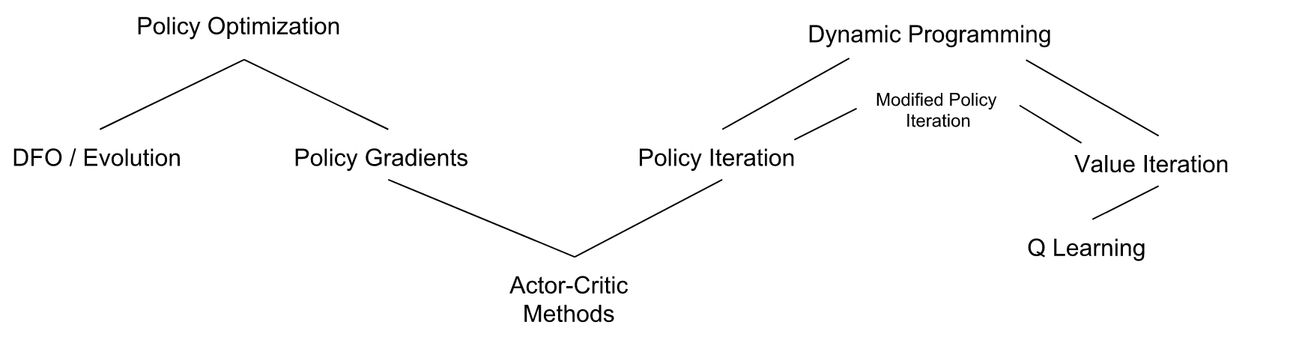
Actor-Critic Algorithms
Agent uses the Value estimate (critic) to update the Policy (actor)
Value function as a baseline for policy gradients
Utilise a learned value function.
RL Landscape
An Introduction to Deep Reinforcement Learning “Big Data & Data Science Meetup” 4th Sep 2017 @ Bogotá, Colombia Vishal Bhalla, Student M Sc. Informatics @ TUM
Notes:
Actor Critic algorithm lies at the intersection of Value and Policy based methods.
In the actor-critic architecture, we have two networks: one is the critic and the other one is the actor.
The critic’s role is to estimate the quality of each action for any given state.
The actor’s role is to use this information to choose the next action to perform.

Slide 29
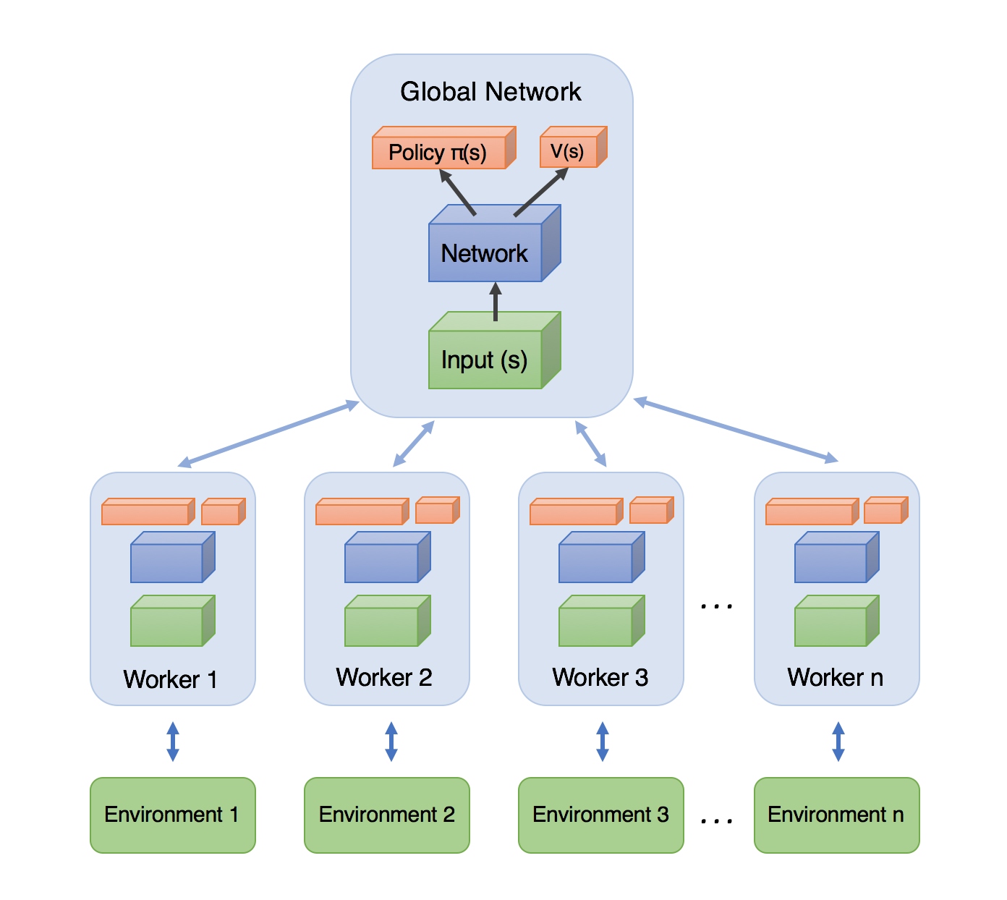
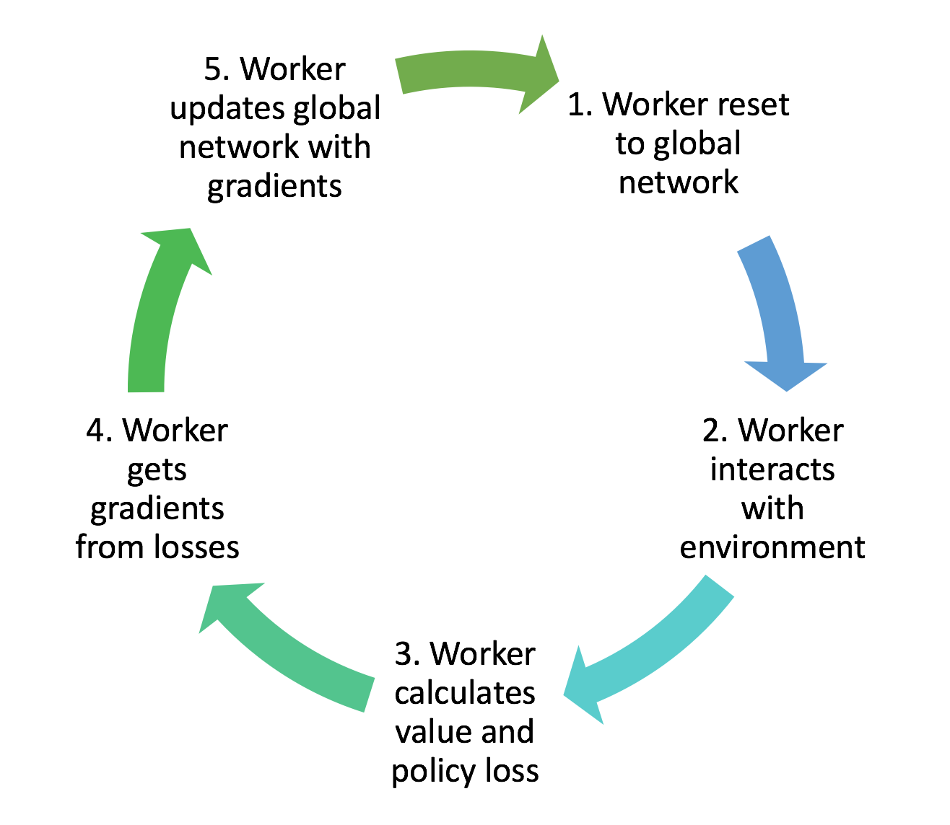
Asynchronous Advantage Actor-Critic (A3C)
A3C utilizes multiple Worker agents
Speedup & Diverse Experience
Combines benefits of Value & Policy Iteration
Continuous & Discrete action spaces
Images(L-R): A3C: Training workflow of each worker agent (L) and High-level architecture (R)
An Introduction to Deep Reinforcement Learning “Big Data & Data Science Meetup” 4th Sep 2017 @ Bogotá, Colombia Vishal Bhalla, Student M Sc. Informatics @ TUM
Notes:
The reason that A3C works better than having a single agent (beyond the speedup of getting more work done), is that the experience of each agent is independent of the experience of the others. In this way the overall experience available for training becomes more diverse.
Actor-Critic combines the benefits of both the value and policy iteration approaches.
In the case of A3C, our network will estimate both a value function V(s) (how good a certain state is to be in) and a policy π(s) (a set of action probability outputs).
These will each be separate fully-connected layers sitting at the top of the network.
Critically, the agent uses the value estimate (the critic) to update the policy (the actor) more intelligently than traditional policy gradient methods.

Slide 30
Break
Notes:
Welcome back from the short break!
In the second part I start off with some of the applications

Slide 31
Use cases
Notes:
Any questions so far? Before we move on to the next section?
“Applications” - I will try to explain how some of these algorithms that we have discussed so far have found use in different applications.

Slide 32
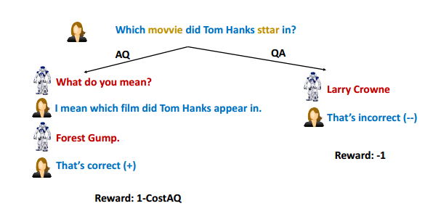
Dialogue Systems: Interactive RL
Conversational flow.
Concept of delayed reward fits well to Dialogue
ICLR 2017 by FAIR: Learning Through Dialogue Interactions By Asking Questions
An Introduction to Deep Reinforcement Learning “Big Data & Data Science Meetup” 4th Sep 2017 @ Bogotá, Colombia Vishal Bhalla, Student M Sc. Informatics @ TUM
Notes:
Fundamental RL Algorithms
Random search does not work well for complex problems where the search space (that depends on the number of possible states and actions) is large. Also, genetic algorithm is a meta-heuristic optimization so it does not provide a guarantee to find an optimal solution.
In the context of conversational agents, we call it dialogue management or Conversation flow and it consists of choosing at each step of the conversation what to say next to the user.
Putting it all in the RL setting, the unknown environment is the users’ behaviour, the actions are the dialogue acts that the system can perform and the rewards may be based on task completion or user satisfaction.
RL fits the dialogue setting quite well because RL is meant for situations when feedback may be delayed. When a conversational agent carries a dialogue with a user, it will often only know at the end whether or not the dialogue was successful and the task was achieved.

Slide 33
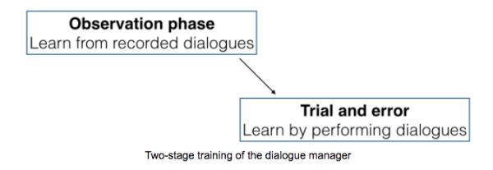
Dialogue Systems: Deep RL
Actor-Critic method
2 Stage training → Supervised Learning + RL
Supervised → Mimic human behaviour
RL → Handle unforeseen situations
User simulations for training
Infinite state space of probability distributions
Dialogue act-slot type combinations
Image courtesy: Maluuba: Applying Deep Reinforcement Learning to Dialogue Management
An Introduction to Deep Reinforcement Learning “Big Data & Data Science Meetup” 4th Sep 2017 @ Bogotá, Colombia Vishal Bhalla, Student M Sc. Informatics @ TUM
Notes:
Consider a practical use case of applying this method at Maluuba that used a Two-stage Training of their dialogue manager to generate Dialogue-Actions
In particular, 2 neural networks - one is the actor and the other is the critic
The critic’s role is to estimate the quality of each action for any given state.
The actor’s role is to use this information to choose the next action to perform.
First, it learns with supervised learning to emulate human decision making from dialogues and
Then it pursues its learning with reinforcement learning by performing conversations itself and learning from its own mistakes. Let the actor and critic make their own decisions and learn from feedback whether they were good or not.
Infinite state space of probability distributions from previous heuristic models that used a heuristic to map the states to a binary vector.
Also, instead of just dialogue actions it can now give more options by combining the dialogue act with slot type combinations.

Slide 34
Key Players & Toolkits
Notes:
Let’s now look at some of the 1. Key research groups, 2. Researches (mostly in industry to follow their work) and 3. Also some of the toolkits that allow to easily build such systems.

Slide 35

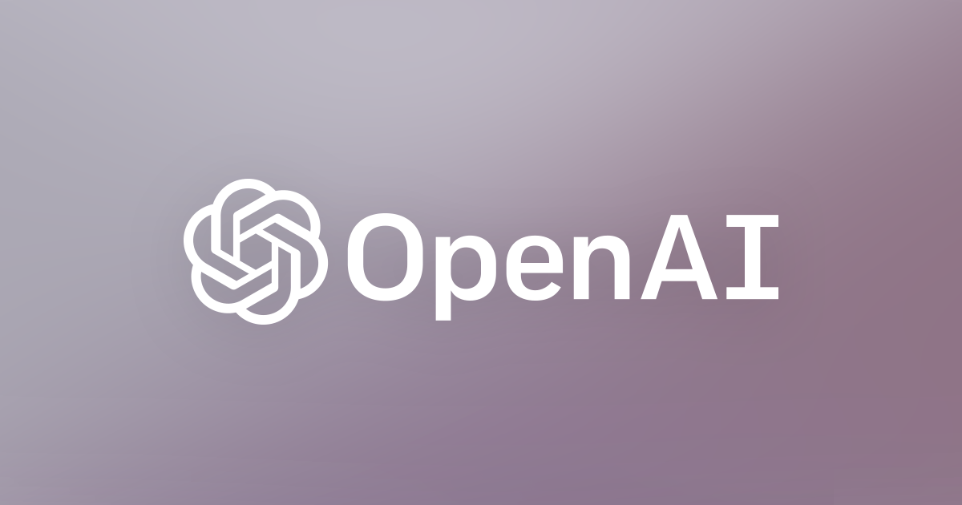


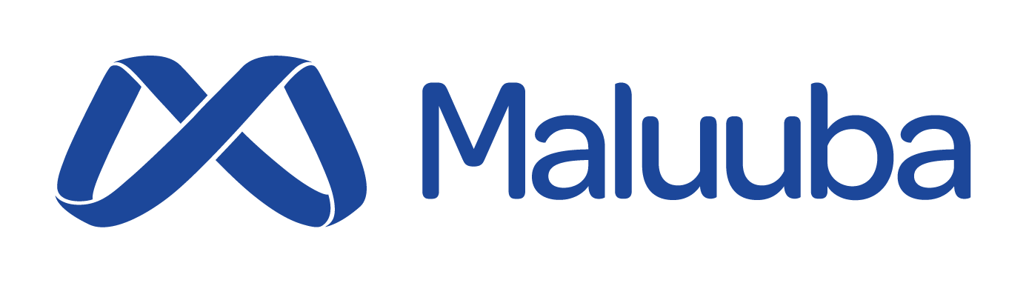

Key Players
An Introduction to Deep Reinforcement Learning “Big Data & Data Science Meetup” 4th Sep 2017 @ Bogotá, Colombia Vishal Bhalla, Student M Sc. Informatics @ TUM
Notes:
OpenAI and DeepMind are two big players in Deep RL !
Other tech giants like Facebook, Microsoft and IBM are also actively incorporating Deep RL in their platforms.
Microsoft acquired Maluuba has extensively used Deep RL in Dialogue Systems use cases for its clients.

Slide 36

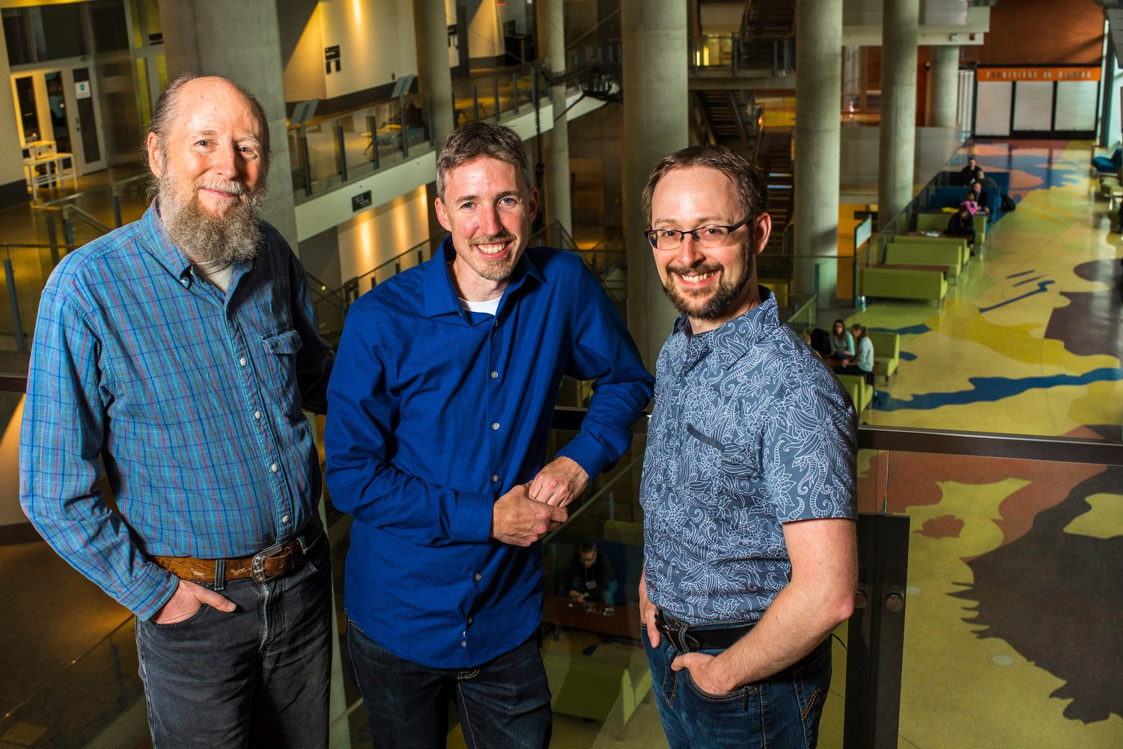
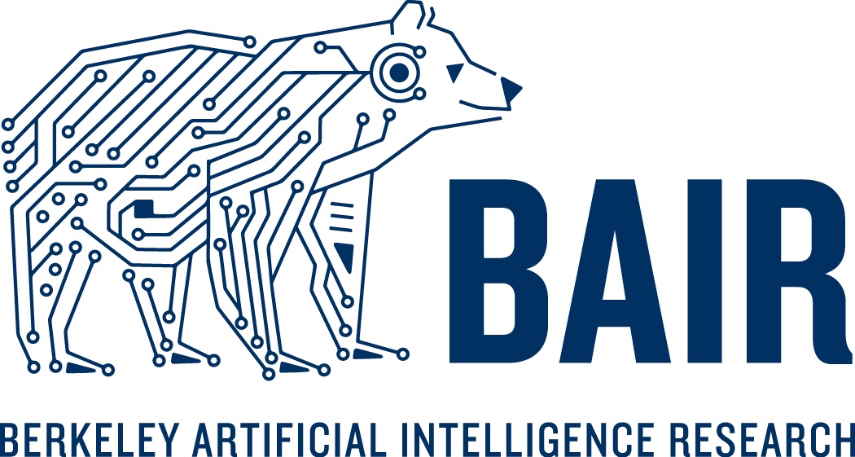
Labs & Groups
Berkeley Artificial Intelligence Research (BAIR) Lab
UC Berkeley EE Department
Univ. of Alberta, Edmonton, Canada
Deep Mind’s 1st international office
Richard Sutton, Michael Bowling and Patrick Pilarski @Univ of Alberta Image courtesy: Deep Mind Blog
An Introduction to Deep Reinforcement Learning “Big Data & Data Science Meetup” 4th Sep 2017 @ Bogotá, Colombia Vishal Bhalla, Student M Sc. Informatics @ TUM

Slide 37
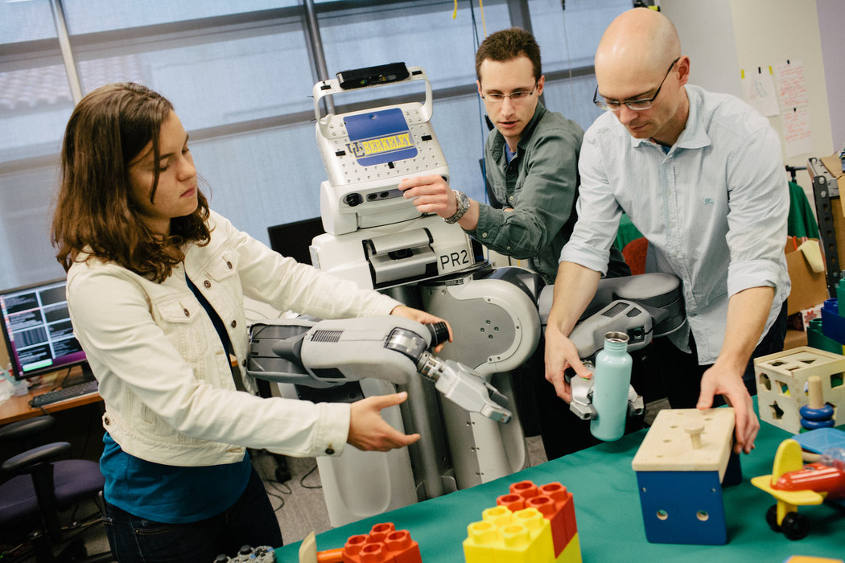
Researchers
Prof. Peter Abeel, Sergey Levine & Chelsea Finn
BAIR, UC Berkeley EE Dept
Rich Sutton
Univ of Alberta
David Silver, Vlad Mnih & Oriol Vinyals
Google DeepMind
Ilya Sutskever, Rocky Duan & John Schulman
Open AI
Marc Deisenroth & Jan Peters
Imperial College London & Max Planck Institute for Intelligent Systems respectively
Chelsea Finn, Sergey Levine & Peter Abeel from UC Berkeley. Image courtesy: The New York Times
Jason Weston
Facebook AI Research (FAIR)
An Introduction to Deep Reinforcement Learning “Big Data & Data Science Meetup” 4th Sep 2017 @ Bogotá, Colombia Vishal Bhalla, Student M Sc. Informatics @ TUM
Notes:
Twitter celebrities, papers? … Who to follow to stay up to date? This is just to name a few and not a comprehensive list!
Prof. Pieter Abeel and his research group at UC Berkeley are active contributors to the community and recently held a bootcamp in Berkeley, California.
Prof. Rich Sutton has made several significant contributions to the field, including temporal difference learning, policy gradient methods and the Dyna architecture
David SIlver’s RL lectures are a must watch and so has been the work at DeepMind. Oriol - one of the Top 40 under 40 AI researchers, switched from Google Brain where he was working on more NeuroScience related stuff to DeepMind to work more on RL based approaches. Vlad Mnih has authored some cool papers.
Ilya Sutskever is the Co-founder and Research Director of OpenAI and along with other researchers have published cool papers in this field. Rock Duan, John Schulman are few of the many OpenAI researchers.
Jason Weston, a Research Scientist @ Facebook AI Research (FAIR) has contributed on work involving deep reinforcement learning techniques for dialogues systems. And so has the other Jason WIlliams from Microsoft.

Slide 38

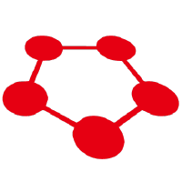
Tools
High-quality implementations of reinforcement learning algorithms
OpenAI Baselines
ChainerRL
Environments with a set of test problems to write & evaluate RL algorithms
OpenAI Gym
RLLab
An Introduction to Deep Reinforcement Learning “Big Data & Data Science Meetup” 4th Sep 2017 @ Bogotá, Colombia Vishal Bhalla, Student M Sc. Informatics @ TUM
Notes:
OpenAI Baselines is a set of high-quality implementations of reinforcement learning algorithms.
ChainerRL implements most of the state of the art algorithms in Chainer which is is a flexible DL library
OpenAI Gym is a toolkit for developing and comparing reinforcement learning algorithms. The gym open-source library, which gives you access to an ever-growing variety of environments.
rllab is a framework for developing and evaluating reinforcement learning algorithms.

Slide 39
Research Frontiers
Notes:
Any questions so far? Before we move on to the next section?
Let’s now explore the challenges and the research frontiers of current deep reinforcement learning algorithms!

Slide 40
Experience Replay
Problem:
Approximate Q-functions using a CNN
Non-linearity is not stable and takes time to converge
Trick:
Store all experiences < s, a, r, s’ > in a replay memory
Use random mini-batches from it
Avoids local minimum by breaking similarity between subsequent training samples
Makes it similar to Supervised Learning
An Introduction to Deep Reinforcement Learning “Big Data & Data Science Meetup” 4th Sep 2017 @ Bogotá, Colombia Vishal Bhalla, Student M Sc. Informatics @ TUM
Notes:
By now we have an idea how to estimate the future reward in each state using Q-learning and approximate the Q-function using a convolutional neural network.
But it turns out that approximation of Q-values using non-linear functions is not very stable. There is a whole bag of tricks that you have to use to actually make it converge. And it takes a long time, almost a week on a single GPU.
The most important trick is experience replay. During gameplay all the experiences < s, a, r, s’ > are stored in a replay memory. When training the network, random mini-batches from the replay memory are used instead of the most recent transition.
This breaks the similarity of subsequent training samples, which otherwise might drive the network into a local minimum.
Also experience replay makes the training task more similar to usual supervised learning, which simplifies debugging and testing the algorithm. One could actually collect all those experiences from human gameplay and then train network on these.

Slide 41
Exploration vs Exploitation?
Agent’s dilemma,
Trust the learnt Q values for every action? Or
Try other actions which might give a better reward?
Q-learning algorithm incorporates a greedy exploration
Fix: 𝛆-greedy approach!
Pick a random action (explore) with probability 𝛜 Or
Select an action according to current Q-values with probability (1-𝛜)
Decrease 𝛜 over time as agent becomes confident
An Introduction to Deep Reinforcement Learning “Big Data & Data Science Meetup” 4th Sep 2017 @ Bogotá, Colombia Vishal Bhalla, Student M Sc. Informatics @ TUM
Notes:
Q-learning attempts to solve the credit assignment problem – it propagates rewards back in time, until it reaches the crucial decision point which was the actual cause for the obtained reward. But we haven’t touched the exploration-exploitation dilemma yet…
Firstly observe, that when a Q-table or Q-network is initialized randomly, then its predictions are initially random as well. If we pick an action with the highest Q-value, the action will be random and the agent performs crude “exploration”. As a Q-function converges, it returns more consistent Q-values and the amount of exploration decreases. So one could say, that Q-learning incorporates the exploration as part of the algorithm. But this exploration is “greedy”, it settles with the first effective strategy it finds.
A simple and effective fix for the above problem is ε-greedy exploration – with probability ε choose a random action, otherwise go with the “greedy” action with the highest Q-value. In their system DeepMind actually decreases ε over time from 1 to 0.1 – in the beginning the system makes completely random moves to explore the state space maximally, and then it settles down to a fixed exploration rate.
An important question is how does the agent select actions during learning. Should the agent trust the learnt values of Q(s, a) enough to select actions based on it ? or try other actions hoping this may give it a better reward. This is known as the exploration vs exploitation dilemma.
A simple approach is known as the 𝛆-greedy approach where at each step. With small probability 𝛜, the agent will pick a random action (explore) or with probability (1-𝛜) the agent will select an action according to the current estimate of Q-values. 𝛜 value can be decreased overtime as the agent becomes more confident with its estimate of Q-values.

Slide 42
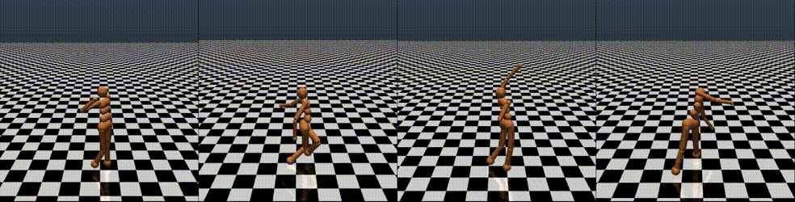
Evolution Strategies
Black-box stochastic optimization
Fit ‘n’ no. of parameters to a single reward function
Tweak and guess iteratively
Tradeoff vs RL
No need for backpropagation
Highly parallelizable
Higher robustness
Structured exploration
Credit assignment over long time scales
Image courtesy: Evolution Strategies as a Scalable Alternative to Reinforcement Learning
An Introduction to Deep Reinforcement Learning “Big Data & Data Science Meetup” 4th Sep 2017 @ Bogotá, Colombia Vishal Bhalla, Student M Sc. Informatics @ TUM
Notes:
It is best to think of ES as simply a class of black-box stochastic optimization techniques.
No need for backpropagation. ES only requires the forward pass of the policy and does not require backpropagation (or value function estimation), which makes the code shorter and between 2-3 times faster in practice. On memory-constrained systems, it is also not necessary to keep a record of the episodes for a later update. There is also no need to worry about exploding gradients in RNNs. Lastly, we can explore a much larger function class of policies, including networks that are not differentiable (such as in binary networks), or ones that include complex modules (e.g. pathfinding, or various optimization layers).
Highly parallelizable. ES only requires workers to communicate a few scalars between each other, while in RL it is necessary to synchronize entire parameter vectors (which can be millions of numbers). Intuitively, this is because we control the random seeds on each worker, so each worker can locally reconstruct the perturbations of the other workers. Thus, all that we need to communicate between workers is the reward of each perturbation. As a result, we observed linear speedups in our experiments as we added on the order of thousands of CPU cores to the optimization.
Higher robustness. Several hyperparameters that are difficult to set in RL implementations are side-stepped in ES. For example, RL is not “scale-free”, so one can achieve very different learning outcomes (including a complete failure) with different settings of the frame-skip hyperparameter in Atari. As we show in our work, ES works about equally well with any frame-skip.
Structured exploration. Some RL algorithms (especially policy gradients) initialize with random policies, which often manifests as random jitter on spot for a long time. This effect is mitigated in Q-Learning due to epsilon-greedy policies, where the max operation can cause the agents to perform some consistent action for a while (e.g. holding down a left arrow). This is more likely to do something in a game than if the agent jitters on spot, as is the case with policy gradients. Similar to Q-learning, ES does not suffer from these problems because we can use deterministic policies and achieve consistent exploration.
Credit assignment over long time scales. By studying both ES and RL gradient estimators mathematically we can see that ES is an attractive choice especially when the number of time steps in an episode is long, where actions have longlasting effects, or if no good value function estimates are available.

Slide 43
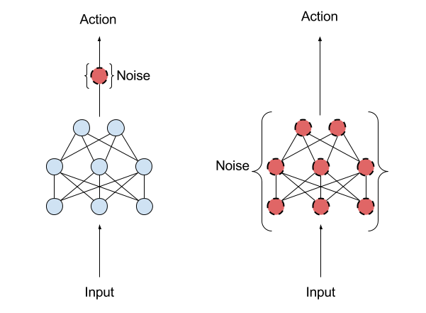
Exploration with Parameter noise
Traditional RL uses action space noise
Parameter space noise injects randomness directly into the parameters of the agent
A middle ground between Evolution Strategies & Deep RL
Image courtesy: Better Exploration with Parameter Noise
An Introduction to Deep Reinforcement Learning “Big Data & Data Science Meetup” 4th Sep 2017 @ Bogotá, Colombia Vishal Bhalla, Student M Sc. Informatics @ TUM
Notes:
Parameter noise adds adaptive noise to the parameters of the neural network policy, rather than to its action space.
Traditional RL uses action space noise to change the likelihoods associated with each action the agent might take from one moment to the next.
Parameter space noise injects randomness directly into the parameters of the agent, altering the types of decisions it makes such that they always fully depend on what the agent currently senses.
The technique is a middle ground between
Evolution strategies (where you manipulate the parameters of your policy but don’t influence the actions a policy takes as it explores the environment during each rollout) and
Deep reinforcement learning approaches like TRPO, DQN, and DDPG (where you don’t touch the parameters, but add noise to the action space of the policy).

Slide 44
Current Research & Other Challenges
Model-based RL
Inverse RL & Imitation Learning - Makes use of GAN’s
Hierarchical (of policies) RL
Multi-agent RL (MARL)
Memory & Attention
Transfer Learning
Benchmarks
An Introduction to Deep Reinforcement Learning “Big Data & Data Science Meetup” 4th Sep 2017 @ Bogotá, Colombia Vishal Bhalla, Student M Sc. Informatics @ TUM
Notes:
The key idea behind Model-based RL is to learn a transition model that allows for simulation of the environment without interacting with the environment directly.
The goal of IRL is to estimate an unknown reward function from observed trajectories that characterise a desired solution
Deep Learning has hierarchy of features. Similarly, Hierarchical RL has hierarchies of Policies!
Multi agent RL (MARL) makes use of communication channels and message passing between multiple agents learning through RL.
Other challenges include Memory and Attention to retain information over long periods, Transfer Learning to exploit previously acquired knowledge from related tasks, having standard Benchmarks for evaluation

Slide 45
Envoi

Slide 46
Summary
Stable and scalable RL is possible
Deep networks represent value, policy and model
Applications - Games, Robotics, Dialogue Systems, etc.
Lot of hacks and advanced Deep RL paradigms required still
Observing the agent is a rewarding experience!
An Introduction to Deep Reinforcement Learning “Big Data & Data Science Meetup” 4th Sep 2017 @ Bogotá, Colombia Vishal Bhalla, Student M Sc. Informatics @ TUM
Notes:
Thanks to Deep RL, stable and scalable RL is now made possible
In this Deep RL system, Deep networks are used represent value, policy and model
It’s applications range from Games to Robotics to Dialogue Systems!
However, a lot of hacks and advanced Deep RL paradigms are required still to make it all work.
Much like how an agent rewards itself after each observation, I hope this was a rewarding experience for you all!

Slide 47
References
Mnih, Volodymyr, Koray Kavukcuoglu, David Silver, Andrei A. Rusu, Joel Veness, Marc G. Bellemare, Alex Graves et al. Human-level control through deep reinforcement learning. [MnihDQN16] In Nature 518, no. 7540 (2015): 529-533.
Mnih, Volodymyr, Adria P. Badia, Mehdi Mirza, Alex Graves, Timothy Lillicrap, Tim Harley, David Silver, & Koray Kavukcuoglu. Asynchronous methods for deep reinforcement learning. [MnihA3C16] In International Conference on Machine Learning, pp. 1928-1937. 2016.
Kai Arulkumaran, Marc Peter Deisenroth, Miles Brundage and Anil Anthony Bharath. A Brief Survey of Deep Reinforcement Learning. [KaiDeepRLSurvey17] In IEEE Signal Processing Magazine, Special Issue on Deep Learning for Image Understanding.
Wang, Ziyu, Victor Bapst, Nicolas Heess, Volodymyr Mnih, Remi Munos, Koray Kavukcuoglu, and Nando de Freitas. Sample efficient actor-critic with experience replay. [WangACExpReplay17] In arXiv preprint arXiv:1611.01224 (2016).
An Introduction to Deep Reinforcement Learning “Big Data & Data Science Meetup” 4th Sep 2017 @ Bogotá, Colombia Vishal Bhalla, Student M Sc. Informatics @ TUM
Notes:
Here are the References …

Slide 48
Additional Links
Blogs
Deep RL (Episode 0-2) blog series by Moustafa Alzantot
Demystifying Deep RL guest post by Tambet Matiisen at Intel-Nervana Systems
Maluuba’s blog on Deep RL for Dialogue Systems
Simple Reinforcement Learning with Tensorflow 8 Part Series by Arthur Juliani
Deep Reinforcement Learning: Pong from Pixels by Andrej Karpathy
DeepRLHacks - "The Nuts and Bolts of Deep RL Research”
Tutorials
Reinforcement Learning: An Introduction, Second Edition by Sutton & Barto.
David Silver's Deep RL video-lectures
Tutorial on Deep RL by Sergey Levine & Chelsea Finn at ICML 2017
Deep RL Bootcamp in Berkeley, California USA
An Introduction to Deep Reinforcement Learning “Big Data & Data Science Meetup” 4th Sep 2017 @ Bogotá, Colombia Vishal Bhalla, Student M Sc. Informatics @ TUM
Notes:
Here are the Reference. I highly recommend reading this material as it also inspired most of the content in this presentation.
Blogs
by Moustafa Alzantot and Intel-Nervana.
Research Blog by Maluuba (acquired by Microsoft) on Deep RL for Dialogue Systems
The 8 part series by Arthur Juliani is a must read for anyone interested in RL.
Andrew Karpathy’s blog explains Policy Gradients quite well.
In terms of Tutorials,
Sutton & Barto online book on RL
David Silver's Deep RL video-lectures are a must and good for beginners to know the basics!
Deep RL Tutorial from ICML last month.
Last week’s Deep RL Bootcamp in Berkeley which I was fortunate to attend.

Slide 49

Questions?
Image courtesy: travelblogadvice
An Introduction to Deep Reinforcement Learning “Big Data & Data Science Meetup” 4th Sep 2017 @ Bogotá, Colombia Vishal Bhalla, Student M Sc. Informatics @ TUM
Notes:
Questions, if any?
(Possible Questions and replies)

Slide 50

Image courtesy: bethratzlaff
An Introduction to Deep Reinforcement Learning “Big Data & Data Science Meetup” 4th Sep 2017 @ Bogotá, Colombia Vishal Bhalla, Student M Sc. Informatics @ TUM
Notes:
Thank You everyone for your time and attention.
I hope I didn’t bore you much. Unfortunately or fortunately we have one more speaker!
And more importantly thank you for not embarrassing me with a lot of questions! Stiffle a giggle …
Jokes apart, I am sure there are lot of passionate people attending this talk today and it would be equally awesome to hear what you are passionate about be it AI, Machine Learning or Deep Reinforcement Learning.
On behalf of all the organizers of this group, I urge you to come up and share your work. With this I end my talk and I look forward to interact with you all during the break and also listening to the next talk! That will be equally interesting. Thank You! :)

Slide 51
Backup Slides

Slide 52
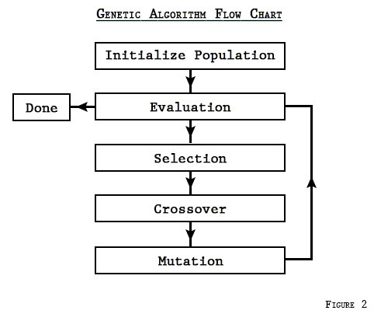
Genetic Algorithm
Evolutionary Computations family of AI
Meta-heuristic optimization method
Requirements
Represent as string of chromosomes (array of bits)
Fitness function to evaluate solutions
Steps
Generation - Pool of candidate solutions
Next Gen- candidate sol with higher fitness value
Selection
Crossover
Mutation
Iterate till solution with goal fitness value
Image courtesy: The Genetic Algorithm - Explained
An Introduction to Deep Reinforcement Learning “Big Data & Data Science Meetup” 4th Sep 2017 @ Bogotá, Colombia Vishal Bhalla, Student M Sc. Informatics @ TUM
Notes:
A genetic algorithm is an example of “evolutionary computation” algorithm which is a family of AI algorithms that are inspired by biological evolution.
These methods are regarded as a meta-heuristic optimization method which means that they can be useful for find good solutions for optimization (maximization or minimization) problems, but they do not provide guarantees of finding the global optimal solution.
Solving a problem by using genetic algorithm require representing its solution as a string of chromosomes (e.g. array of bits) and requires also having a fitness function that can be used to evaluate the solutions.
Steps of genetic algorithm
A genetic algorithm works by maintaining a pool of candidate solutions (named generation).
Iteratively, the generation evolved to produce the next generation which has candidate solutions with higher fitness values than the previous generation.
This process is repeated for a pre-specified number of generations or until a solution with goal fitness value is found.
The next generation is created from current generation in a biologically inspired manner that consists of 3 steps:
Selection: we evaluate the fitness of members of the current generation, then we select the subset with the best fitness values in order to act as parents for the next generation. In short, survival for the fittest.
Crossover: we merge pairs from the selected parents to generate new offspring child solution. Crossover can happen in different forms, simplest form is the one-point crossover which splits the string representation of each solutions into two parts at the same position, then concatenate the first part of one solution with the second part of the second one to form the offspring solution representation. I
Mutation: In biology, mutation happens with low probability where a child can have a feature that was not inherited from the parents. Likewise, in genetic algorithm mutation step perturbs the offspring solution with very small probability (e.g. flipping one bit of the bitstring representation of the solution)

Slide 53
The End

